Slide 1
Optimal Decisions:
MCDM Methods
By Sina Azartash
Johns Hopkins: Whiting School Of Engineering
sazarta1@jh.edu

Slide 2
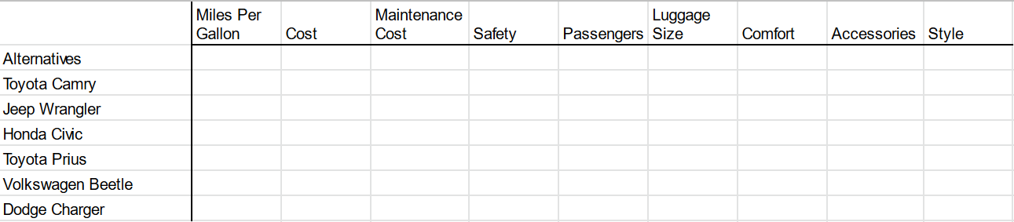
Which would be the best car for you?
The row that achieves the highest score is the best row
Each column contributes to the score of a row
Decision aid to choose the best job, best dried noodles at the grocery store, best service provider….etc
Notes:
Imagine you are trying to pay

Slide 3
Background
Multi-Criteria Decision Making (MCDM) - make the most optimal decisions
Multi-Criteria Decision Analysis (MCDA) - study how optimal are decisions
Rows: Alternatives, Decision, Choice, Solution
Columns: Attributes, Factors, Variables, Objective
Often, there is no single best decision, but a set of decisions
Preference: used to describe how close a solution is to the ideal solution
Ideal Solution: a theoretical point in which all attributes are maximized.
Pareto Optimal Solution: a solution in which there is no other solution that is better

Slide 4
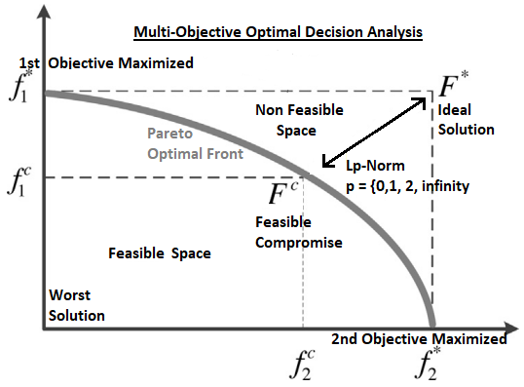
Algorithm Framework
Pareto Optimal Front → the best solutions that currently exists
Graph shows only 2 objectives. Example: Safety vs Cost.
if more objectives, then it would be hyper-dimensional graph

Slide 5
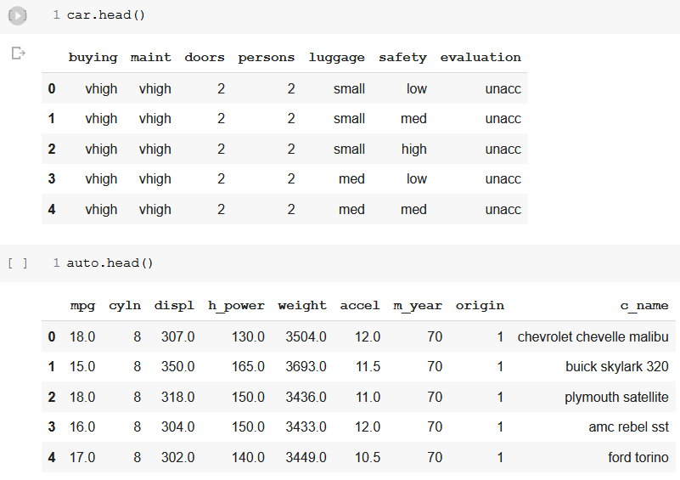
DataSets
UCI Machine Learning Repository
1) Car = Car Evaluate
Best Economy Car
2) Auto = Auto MPG
Best Race Car

Slide 6
Method Overview
Removed Less Relevant Columns
Can we use car name to evaluate our alternatives?
Can we use number of passengers or car doors?
Check For Null Values
Convert To Categorical to Numerical Float
We used Ordinal Encoding
Fill in missing values
K-mean Nearest Neighbors Imputer
Check For Null Values Again
Delete Duplicate Rows
We want only one of each alternative
Normalize
We divided by the max
Weigh the Columns
How much does each column contribute to the alternative
Feed Into Algorithm
Compare Algorithms
Notes:
Well, why not logarithmic normalization? Why not other normalization methods? Well I would use those if I was trying to get the best possible estimate with more data and more columns.

Slide 7
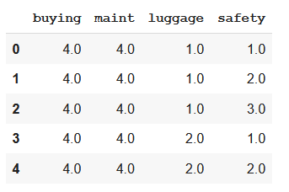
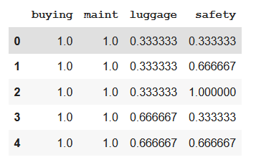
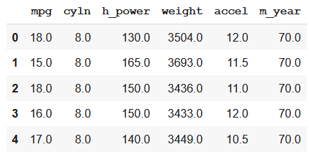
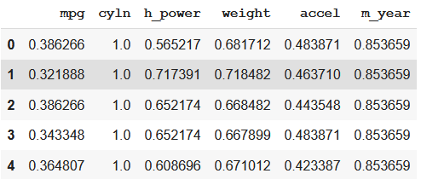
Data After Preprocessing

Slide 8
Weighing the Columns
Auto MPG: Best Race Car
Miles Per Gallon - 33%
Cylinders - 75%
Horse_power - 90%
Weight - 80%
Acceleration - 100%
Year Made - 33%
Car Evaluation: Best Economy Car
Buying Cost - 75%
Maintenance - 85%
Luggage Size - 50%
Safety - 100%
Subjective Weighing
We decide the importance of each columns
Heavily influences the results of the MCDM algorithms

Slide 9
Implementation
pyMCDM by Massachusetts Institute of Technology
!pip install pymcdm
TOPSIS - basic most popular method
VIKOR - based on fuzzy logic
PROMETHEE-II - good for uncertainty
SPOTIS - resistant to rank reverse paradox
COMET - resistant to reverse order paradox

Slide 10
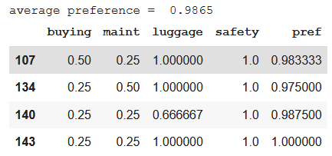
COMET on Car Evaluation
Top 5 best choices among choices above or equal to 97.5th percentile
98.65% avg based on 97.5% set
Vehicle # 143:
Maximum safety
Maximum luggage
Minimum Cost
Minimum Maintenance
Vehicle # 140
All factors are maximized
except luggage
Vehicle # 134
All factors are maximized except cost, but cost is more important than luggage which results in lower preference

Slide 11
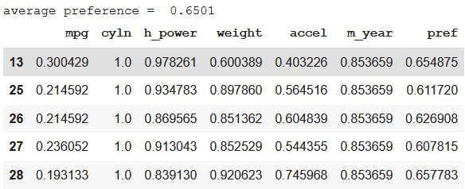
COMET on Auto MPG
Top 5 best choices among choices above or equal to 97.5th percentile
65.01% avg based on 97.5% set
Vehicle # 13:
Lower MPG
8 cylinders (max)
High Horsepower
Medium Accel
Medium Weight
Newer model
Vehicle # 28
Similar to Vehicle #13
However, much heavier, slightly less horsepower, but much more acceleration
Overall
Vehicles listed in Auto-mpg dataset had much lower preference values

Slide 12
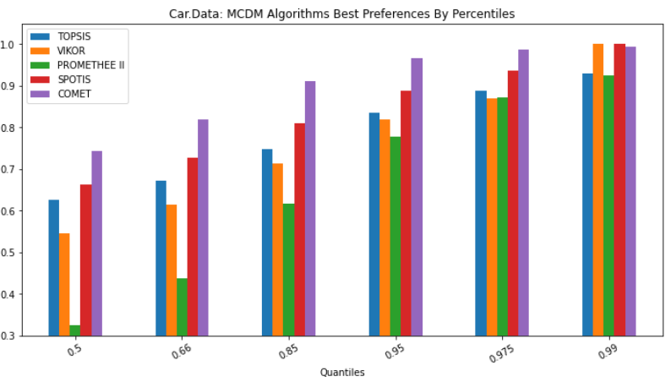
Algorithm Performance on Top Best Percentile Choices
X-axis = percentile; threshold for ‘x%’ best choices
Y-axis = ranking of the alternative

Slide 13
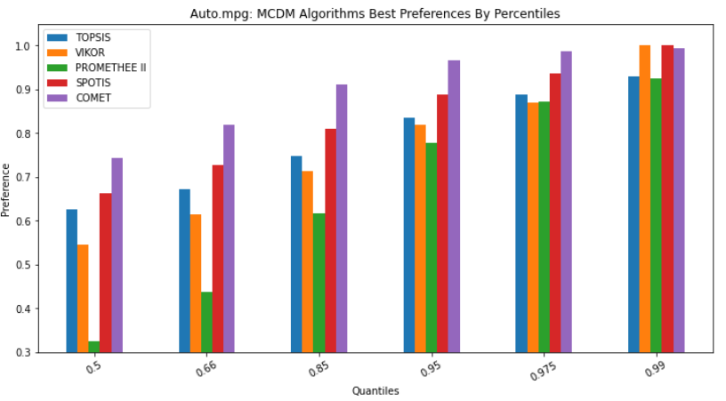
Auto Dataset Produced Same Trend

Slide 14
Disclaimers
This study is not making a point about the performance of these algorithms
Rather this study examines which algorithms were best suited to these two datasets
Graphing the differences in computational time between the algorithms and the datasets

Slide 15
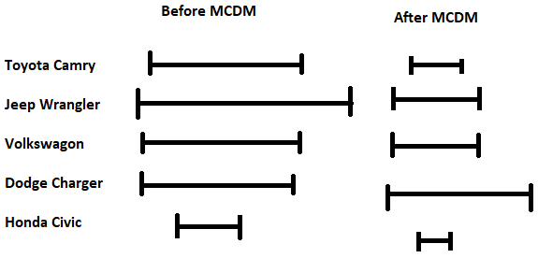
A Few Problems
More columns results in less accuracy and slower calculation
We are not so much picking the best decision as so much as we are reducing the uncertainty with that decision
Rank Reversal Paradox
Removing non optimal points from the list affects what is considered optimal
Picking the best choice amongst all the subsets might not be the best overall choice
Other attributes:
Gas tank size
Ratings of the car
Lifespan of the car
Opinion of friends/family
Environmentally friendly
Financing
Vehicle History (if used)
Has warranty?
Spaciousness
Discount
Etc etc.
Notes:
Are we really making an optimal decision?

Slide 16
END

Slide 17
Optimal Decisions:
MCDM Methods
By Sina Azartash
Johns Hopkins: Whiting School Of Engineering
sazarta1@jh.edu

